Slide 1
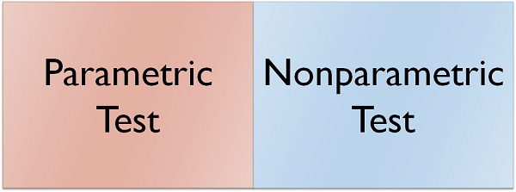
Alok Yadav

Slide 2
A "Statistic" is a measure of a property of a Sample, for example, the Sample Mean or Sample Standard Deviation.
The corresponding term for a Population or Process is "Parameter". The most commonly used statistical tests are "Parametric", that is, they require that one or more Parameters meet certain conditions or "assumptions".
Most frequently, the assumption is that the Distribution of the Population or Process is roughly Normal.
Roughly equal Variance is also a common assumption. If these conditions are not met, the Parametric test cannot be used, and a Nonparametric test must be used instead. This table shows the Nonparametric test that can be used in place of several common Parametric tests.

Slide 3
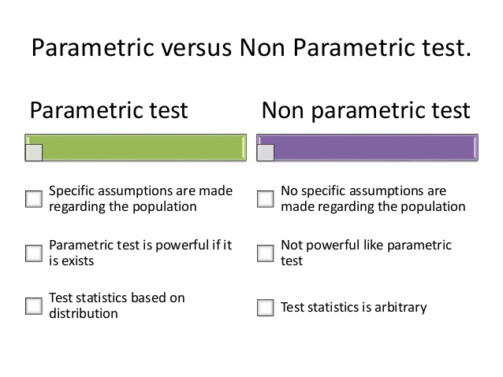

Slide 4
One Categorical Predictor
So you want to explain a numeric outcome variable with one categorical predictor.
Question: How many groups does your categorical variable have?
Two Groups
More than two Groups
Example: You want to determine if cats and dogs sleep a different amount.
Example: You want to see if math, biology, and English majors spend a different amount on textbooks.

Slide 5
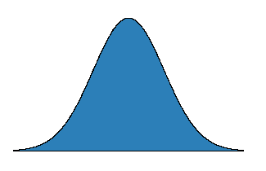
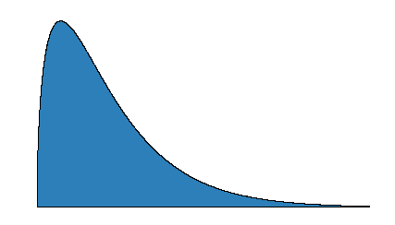
Normal
Testing a Claim
So you want to test if the mean of a numeric variable from a single population equals some claimed value.
Question: What is the shape of your variable’s distribution?
Not Normal
A normal distribution is the classic bell curve. It is symmetric, with most cases falling near the mean and fewer cases falling away from the mean in either tail.
If the variable’s distribution is skewed (has a tail in either direction), has more than one mode (peak), or contains outliers, then it will fail the normality assumption of many common statistical methods.

Slide 6
Two Groups
So you want to test if the mean of a numeric outcome differs across two groups.
Question: Are your measurements paired or independent?
Paired
Independent
Normal
Not Normal
Both Groups are Normal
One or Both Groups are Not Normal
Paired t-Test
Sign Test
Two-Sample Independent t-Test
Mann-Whitney U-Test

Slide 7
Independent Groups
So you want to test if the mean of a numeric outcome differs between two independent groups.
Question: Are the distributions for both groups normal?
Both Groups are Normal
One or Both Groups are not Normal
Paired t-Test
Sign Test

Slide 8
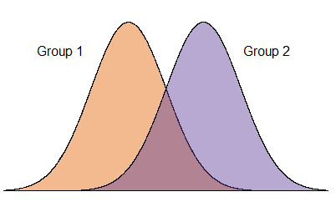
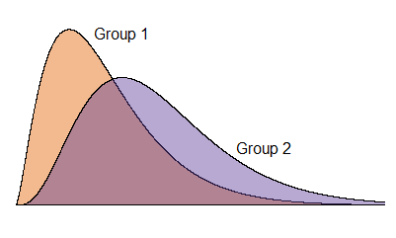
Normal
Independent Groups
Not Normal
Both Groups are Normal
One or Both Groups are not Normal
A normal distribution is the classic bell curve.
It is symmetric, with most cases falling near the mean and fewer cases falling away from the mean in either tail.
If the variable’s distribution is skewed, has more than one mode (peak), or contains outliers, then it will fail the normality assumption of many parametric statistical methods.

Slide 9
Independent Groups
So you want to test if the mean of a numeric outcome differs between two independent groups.
Question: Are the distributions for both groups normal?
Both Groups are Normal
One or Both Groups are not Normal
Two-Sample Independent t-Test
Mann-Whitney U-Test

Slide 10
More than two Groups
Kruskal-Wallis Test
http://sites.utexas.edu/sos/guided/inferential/numeric/onecat/more-than-2/kruskal-wallis/
The non-parametric analogue for a one-way ANOVA test is the Kruskal-Wallis test.
. Remember that a non-parametric test is used when the distribution is either highly skewed or we are comparing ordinal or rank ordered data.
Example of a skewed distribution 1 2 3 4 5 6

Slide 11
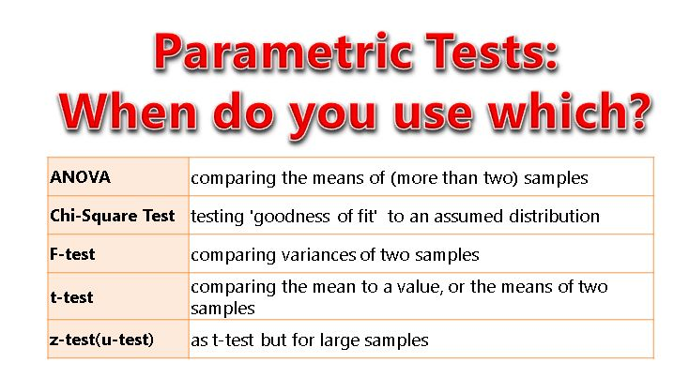

Slide 12
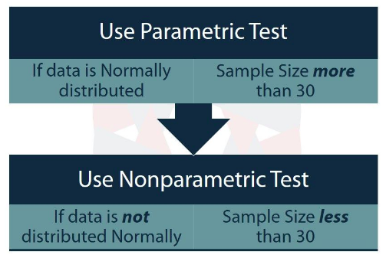

Slide 13
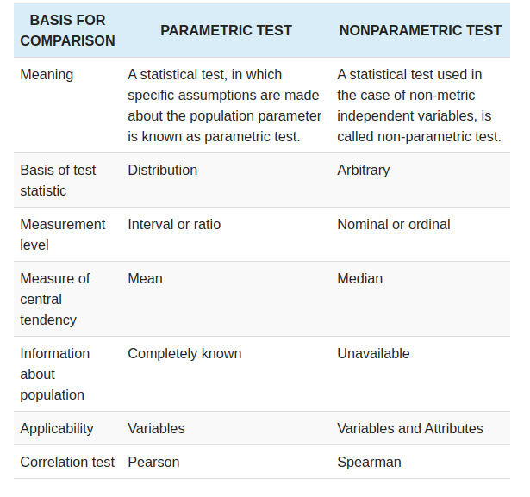

Slide 14
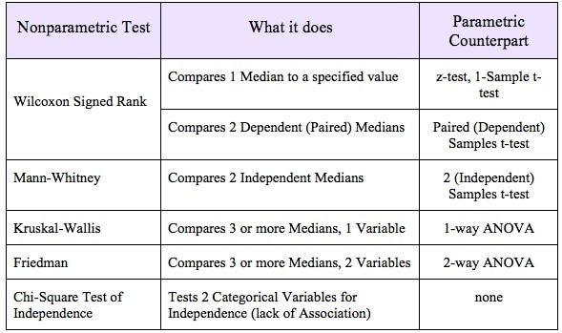

Slide 15
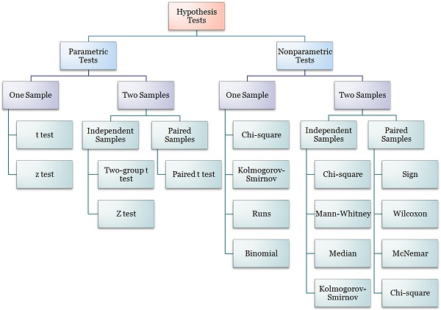

Slide 16
http://sphweb.bumc.bu.edu/otlt/MPH-Modules/BS/BS704_Nonparametric/BS704_Nonparametric7.html

Slide 17
Which Non Parametric Tests To Apply When:
While dealing with hypothesis testing, we come across situations where nothing can be assumed about the population distribution, or when the data is not present in representable numerical form (ordinal or nominal data).
In such situations, the basic assumptions for the parametric tests don’t hold true and non parametric tests are used.
Nonparametric tests take into account fewer assumptions as compared to parametric tests.
They don’t assume anything beforehand about the probability distribution of the population and hence are referred to as distribution-free tests.
They are readily comprehensible and easy to use.

Slide 18
The hypotheses which can be tested using nonparametric tests are:
Testing whether two independent samples come from identical populations
Testing whether the samples are drawn from populations having an identical median
Testing the randomness of one sample or two samples
To test if a sample comes from specified theoretical distribution

Slide 19
The Mann-Whitney U test is the nonparametric equivalent of the two sample t-test.
While the t-test makes an assumption about the distribution of a population (i.e. that the sample came from a t-distributed population), the Mann Whitney U Test makes no such assumption.

Slide 20
Null Hypothesis for the Test:
The test compares two populations.
The null hypothesis for the test is that the probability is 50% that a randomly drawn member of the first population will exceed a member of the second population.
Alternate Hypothesis:
An alternate null hypothesis is that the two samples come from the same population (i.e. that they both have the same median).

Slide 21
MANN-WHITNEY U TEST (Wilcoxon rank sum test):
Mann-Whitney U test uses the ranks assigned to the sample observations to determine whether two samples come from the identical population.
In this test, we assume that the samples are independent and the observations are at least ordinal for the sake of ranking.
If the samples are drawn from identical populations then it can be assumed that the mean of ranks assigned to both the samples is more or less the same.

Slide 22
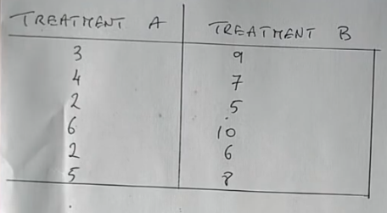

Slide 23
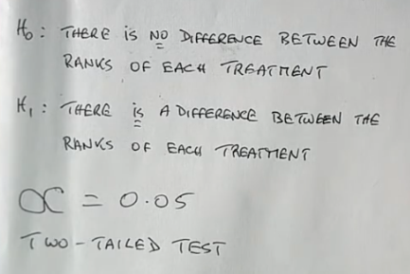

Slide 24
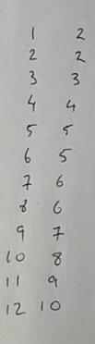
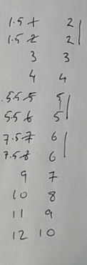
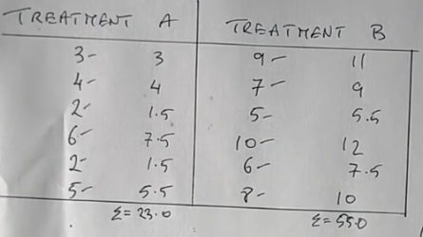

Slide 25
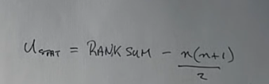
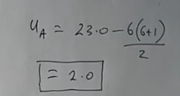
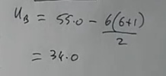


Slide 26
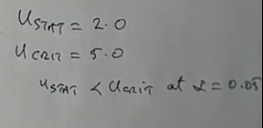

Slide 27
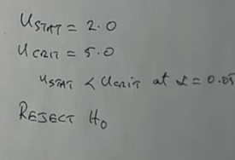

Slide 28
https://content.wisestep.com/advantages-disadvantages-parametric-tests/

Slide 29
KRUSKAL WALLIS One Way Analysis Of Variance By Ranks
The Kruskal Wallis one way analysis of variance is a useful test when several independent samples are involved. It helps in deciding whether k (>2) independent samples are from the same population or identical population with the same median or not.
It is assumed that the observations are independent and at least ordinal. In a similar fashion to Mann-Whitney U test, this test also begins with ranking the observations in ascending order. Now, the average ranks of the samples must be about the same if they are from the same populations. To test if they are about the same the Kruskal Wallis test statistic is given as:

Slide 30
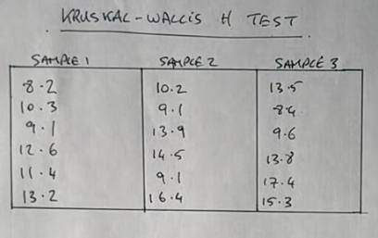

Slide 31
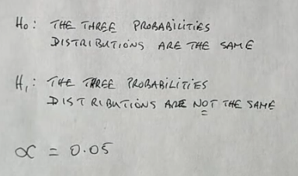

Slide 32
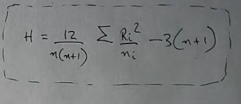

Slide 33
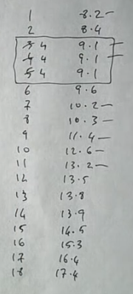

Slide 34
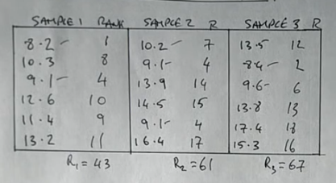

Slide 35
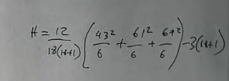

Slide 36
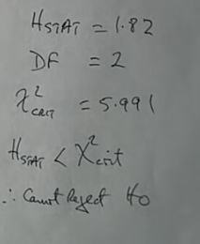

Slide 37
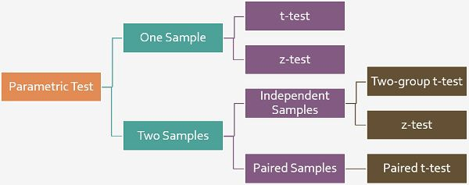
Difference Between T-test and Z-test:
T-test refers to a univariate hypothesis test based on t-statistic, wherein the mean is known, and population variance is approximated from the sample.
On the other hand, Z-test is also a univariate test that is based on standard normal distribution.

Slide 38
Difference Between T-test and Z-test

Slide 39
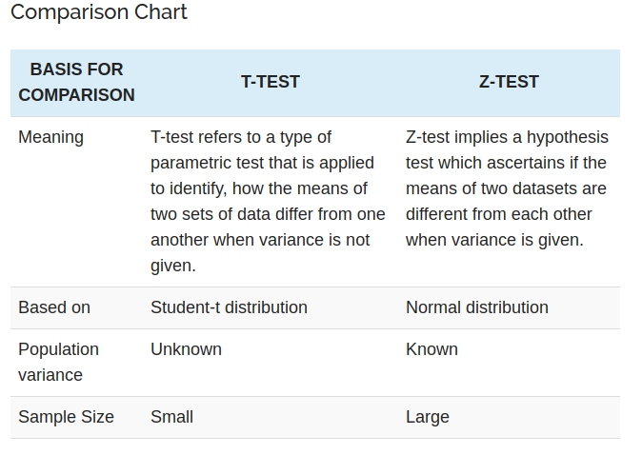

Slide 40
Assumptions of T-test:
All data points are independent.
The sample size is small. Generally, a sample size exceeding 30 sample units is regarded as large, otherwise small but that should not be less than 5, to apply t-test.
Sample values are to be taken and recorded accurately.

Slide 41
Definition of T-test
A t-test is a hypothesis test used by the researcher to compare population means for a variable, classified into two categories depending on the less-than interval variable.
More precisely, a t-test is used to examine how the means taken from two independent samples differ.
T-test follows t-distribution, which is appropriate when the sample size is small, and the population standard deviation is not known.
The shape of a t-distribution is highly affected by the degree of freedom.
The degree of freedom implies the number of independent observations in a given set of observations.

Slide 42
Assumptions of T-test:
All data points are independent.
The sample size is small.
Generally, a sample size exceeding 30 sample units is regarded as large, otherwise small but that should not be less than 5, to apply t-test.
Sample values are to be taken and recorded accurately.

Slide 43

The test statistic is:
x ̅is the sample mean s is sample standard deviation n is sample size μ is the population mean

Slide 44
Paired t-test: A statistical test applied when the two samples are dependent and paired observations are taken.

Slide 45
Definition of Z-test
Z-test refers to a univariate statistical analysis used to test the hypothesis that proportions from two independent samples differ greatly.
It determines to what extent a data point is away from its mean of the data set, in standard deviation.
The researcher adopts z-test, when the population variance is known, in essence, when there is a large sample size, sample variance is deemed to be approximately equal to the population variance. In this way, it is assumed to be known, despite the fact that only sample data is available and so normal test can be applied.

Slide 46

Assumptions of Z-test:
All sample observations are independent
Sample size should be more than 30.
Distribution of Z is normal, with a mean zero and variance 1.
The test statistic is:
x ̅is the sample mean σ is population standard deviation n is sample size μ is the population mean

Slide 47
Key Differences Between T-test and Z-test
The difference between t-test and z-test can be drawn clearly on the following grounds:
The t-test can be understood as a statistical test which is used to compare and analyse whether the means of the two population is different from one another or not when the standard deviation is not known.
As against, Z-test is a parametric test, which is applied when the standard deviation is known, to determine, if the means of the two datasets differ from each other.
The t-test is based on Student’s t-distribution. On the contrary, z-test relies on the assumption that the distribution of sample means is normal. Both student’s t-distribution and normal distribution appear alike, as both are symmetrical and bell-shaped. However, they differ in the sense that in a t-distribution, there is less space in the centre and more in the tails.
One of the important conditions for adopting t-test is that population variance is unknown. Conversely, population variance should be known or assumed to be known in case of a z-test.
Z-test is used to when the sample size is large, i.e. n > 30, and t-test is appropriate when the size of the sample is small, in the sense that n < 30.

Slide 48
Conclusion
By and large, t-test and z-test are almost similar tests, but the conditions for their application is different, meaning that t-test is appropriate when the size of the sample is not more than 30 units. However, if it is more than 30 units, z-test must be performed. Similarly, there are other conditions, which makes it clear that which test is to be performed in a given situation.

Slide 49
Key Differences Between T-test and Z-test
The difference between t-test and z-test can be drawn clearly on the following grounds:
The t-test can be understood as a statistical test which is used to compare and analyse whether the means of the two population is different from one another or not when the standard deviation is not known. As against, Z-test is a parametric test, which is applied when the standard deviation is known, to determine, if the means of the two datasets differ from each other.
The t-test is based on Student’s t-distribution. On the contrary, z-test relies on the assumption that the distribution of sample means is normal. Both student’s t-distribution and normal distribution appear alike, as both are symmetrical and bell-shaped. However, they differ in the sense that in a t-distribution, there is less space in the centre and more in the tails.
One of the important conditions for adopting t-test is that population variance is unknown. Conversely, population variance should be known or assumed to be known in case of a z-test.
Z-test is used to when the sample size is large, i.e. n > 30, and t-test is appropriate when the size of the sample is small, in the sense that n < 30.

Slide 50
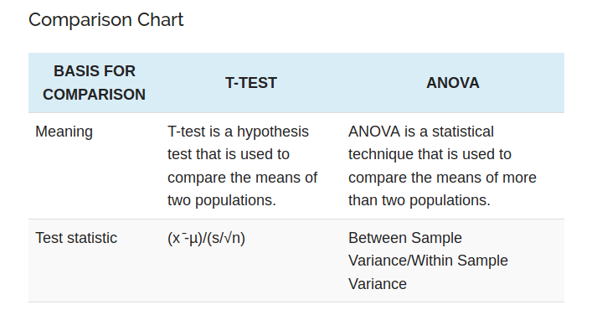

Slide 51
https://keydifferences.com/difference-between-one-tailed-and-two-tailed-test.html

Slide 52
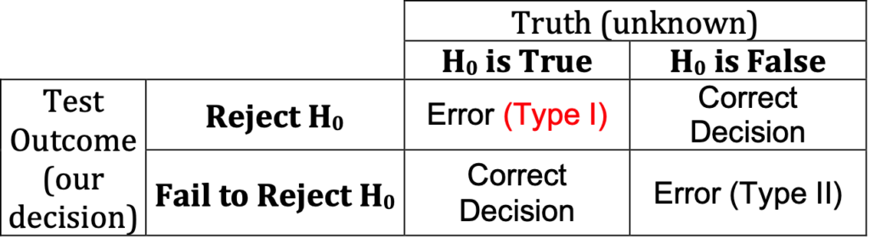

Slide 53
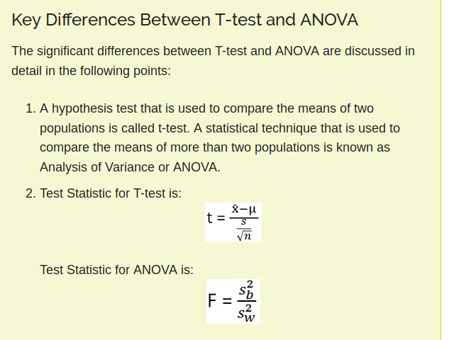

Slide 54
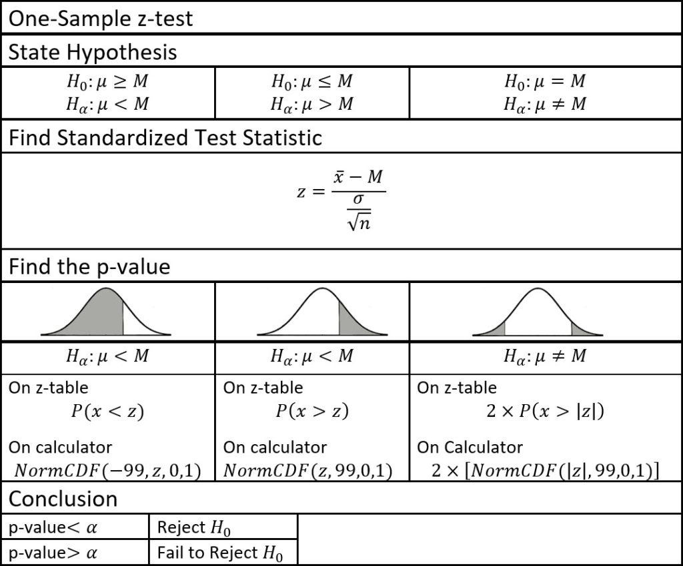

Slide 55
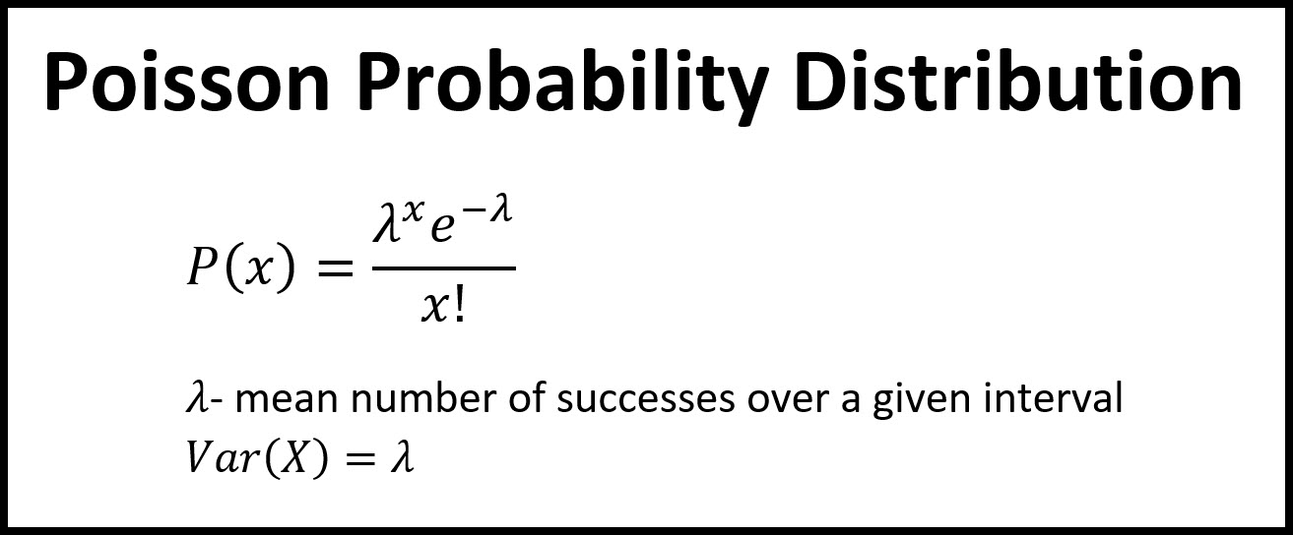

Slide 56
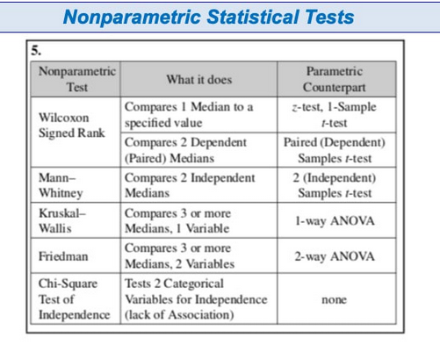

Slide 57
Binomial Distribution
The prefix ‘Bi’ means two or twice.
A binomial distribution can be understood as the probability of a trail with two and only two outcomes.
It is a type of distribution that has two different outcomes namely, ‘success’ and ‘failure’ (a typical Bernoulli trial).
It is applicable to discrete random variables only.
The origin of Binomial distribution can be traced back to Bernoulli’s trial.

Slide 58
Bernoulli Trials
The binomial distribution is the total or the sum of a number of different independents and identically distributed Bernoulli Trials.
In this experiment, the trials are to be random and could have only two outcomes whether it can be success or failure.
The flipping of a coin is the best example of Bernoulli trials; each trial can only produce one of the two values- heads or tails.
Each time you flip the coin there is a 50% probability of the outcome.
The outcome never affects or influences the other.

Slide 59
Binomial Distribution Examples
Let’s take some real-life instances where you can use the binomial distribution.
If the WHO introduced a new cure for a disease then there is an equal chance of success and failure. It can either cure the diseases or not.
If you are purchasing a lottery then either you are going to win money or you are not.
In other words, anywhere the outcome could be a success or a failure that can be proved through binomial distribution.

Slide 60
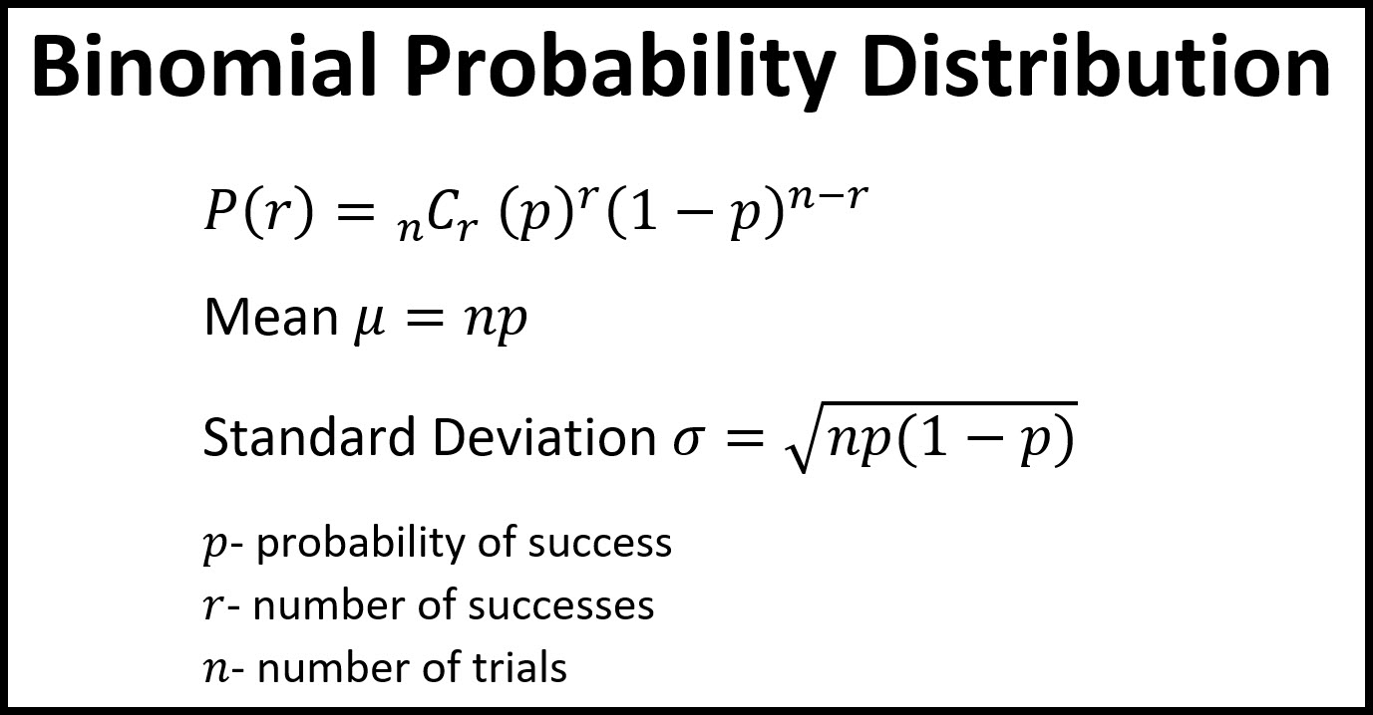

Slide 61
If a coin is tossed 10 times then what is the chances of getting exactly 6 heads?
formula – b(x,n,p)= nCx*Px*(1-P)n-x
The number of trials is 10 (n)
The odds of success (tossing heads) is 0.5 (p)
So, 1-p = 0.5, x= 6
P(x=6) = 10C6 × 0.56 × 0.54 = 210 × 0.015625 × 0.0625 = 0.205078125

Slide 62
Mean and Variance of a Binomial Distribution
Mean(µ) = np Variance(σ2) = npq
The variance of a Binomial Variable is always less than its mean. ∴ npq<np.
For Maximum Variance: p=q=0.5 and σmax = n/4.

Slide 63
An experiment is a binomial experiment if:
1. It is repeated a fixed number of times.
2. The trials are independent.
3. Trials have two mutually exclusive outcomes, either success or failure.
4. The probability of success is the same for all trials.

Slide 64
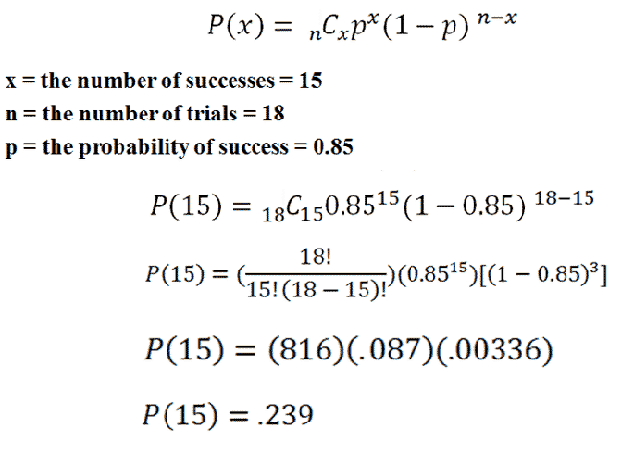
In a recent survey, it was found that 85% of households in the United States have High-Speed Internet. If you take a sample of 18 households, what is the probability that exactly 15 will have High-Speed Internet
By following the above steps, you should find that the probability of 15 households having High-Speed Internet is .239.

Slide 65
In a recent survey, it was found that 85% of households in the United States have High-Speed Internet. If you take a sample of 18 households, what is the probability that at least 15 will have High-Speed Internet?
http://statisticslectures.com/topics/statistics/

Slide 66
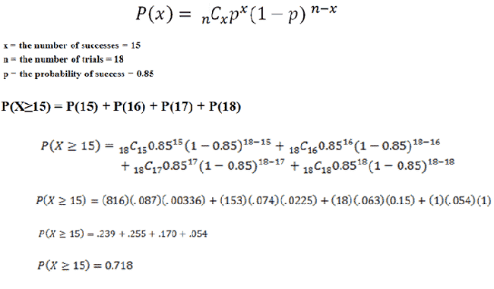
It says "at least" 15, so that means we have to calculate the probabilties for 15, 16, 17, and 18 homes, then add everything together:
By following these steps, you should find that the probability of at least 15 households having High-Speed Internet is .718.

Slide 67
Problem: 80% of people those who purchase pet insurance are women. If the owners of 9 pet insurance are randomly selected, then find the probability that exactly 6 out of them are women.

Slide 68
Solution:
Here are the steps.
Find out the ‘n’ from the problem. Here n = 9
Identify ‘X’. X = the number you are asked to search the probability for is 6.
(Divide the formula then it become easy to get the solution) solve the first part of the formula: – n! / (n-X)! X!
Now add the variables = 9! (9-6)!*6! = 84. And keep it aside for further uses.

Slide 69
Now find out the P and Q.
P= the probable chances of success and Q= the possibility of failure. As mentioned in the above question p = 80% or 0.8 so, the probability of failure = 1-0.8 = 0.2 (20%)
Now let’s do the second part of the formula. Px = 0.86= 0.262144
Q(n-x)= 0.2(9-6) = 0.23 = 0.008 (third part of the formula)
Multiply the answer you get from step 3, 5, 6 together
8×0.262144×0.008 = 0.176

Slide 70
https://newonlinecourses.science.psu.edu/stat414/
http://sphweb.bumc.bu.edu/otlt/mph-modules/bs/bs704_nonparametric/BS704_Nonparametric-TOC.html

